Slide 1
PROJECT TITLE
CAPSTONE PROJECT
Presented By: KHUSHBOO
Student Name : KHUSHBOO
College Name & Department : DRONACHARYA COLLEGE OF ENGINEERING & CSE(IOT including blockchain technology and cybersecurity)

Slide 2
OUTLINE
Problem Statement
Technology used
Wow factor
End users
Result
Conclusion
Git-hub Link
Future scope

Slide 3
Problem Statement
Develop a Steganography technique to securely hide encrypted text inside images.
Ensure data security and confidentiality by preventing unauthorized access.
Implement a detection and decryption mechanism for retrieving hidden text.
Maintain image integrity while embedding secret information.

Slide 4
Technology used
Programming Language : Python
Image Processing Library : OpenCV
Graphical User Interface(GUI): Tkinter
File Handling and Security : Basic encryption logic for password protection
Additional Libraries : Pillow (for image handling)
Platform : Windows 11

Slide 5
Wow factors
Uses steganography to embed a message into an image without noticeable changes.
User-friendly GUI for easy encryption and decryption.
Lossless data hiding using pixel value manipulation instead of traditional cryptographic techniques.
Works on any standard image file format .

Slide 6
End users
Cybersecurity Enthusiasts – Exploring secure communication techniques.
Government & Defense – Secure message transmission without raising suspicion.
Journalists & Activists – Concealing sensitive information in images to avoid surveillance.
Software Developers – Learning steganography concepts and their applications .

Slide 7
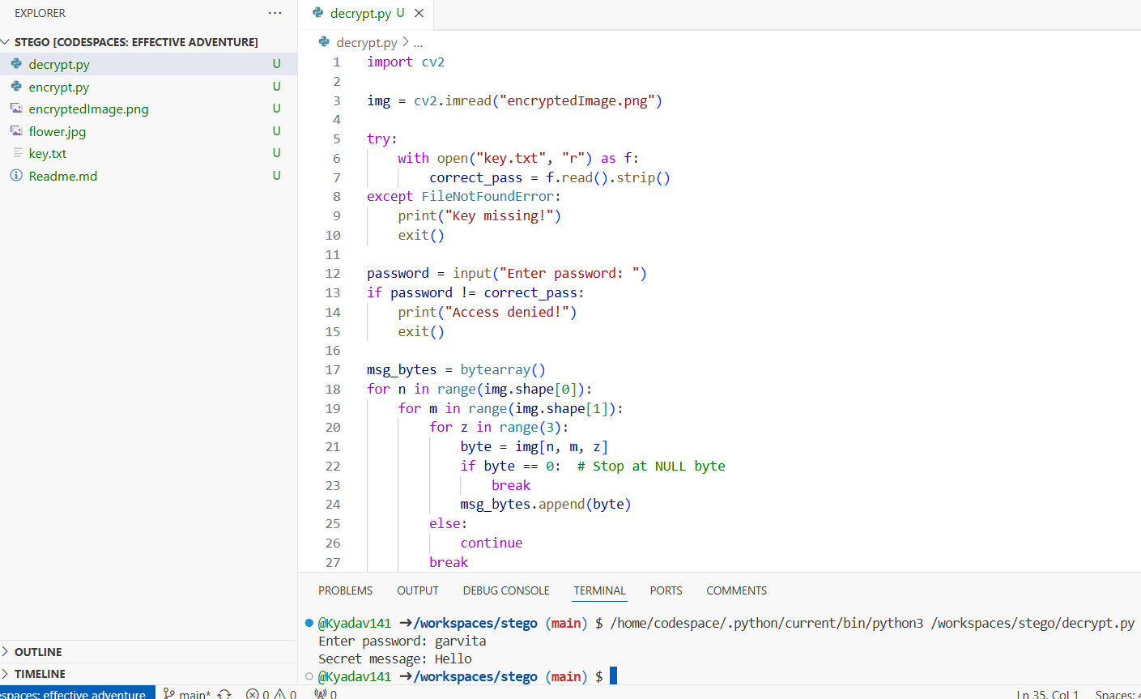
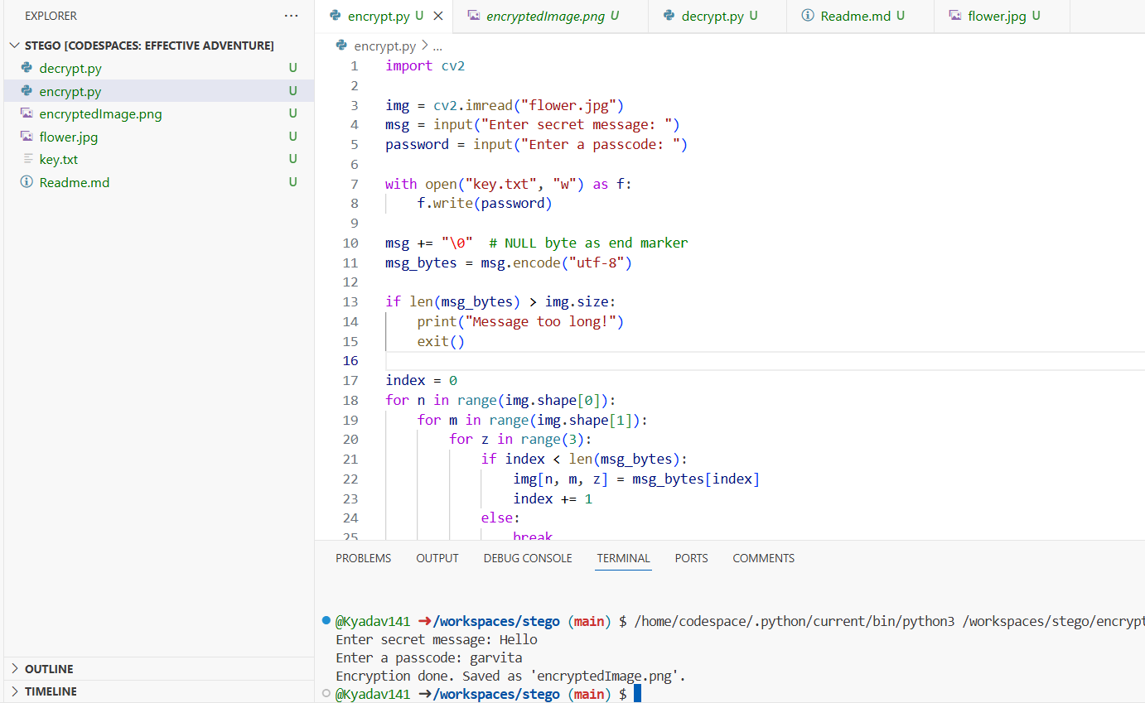
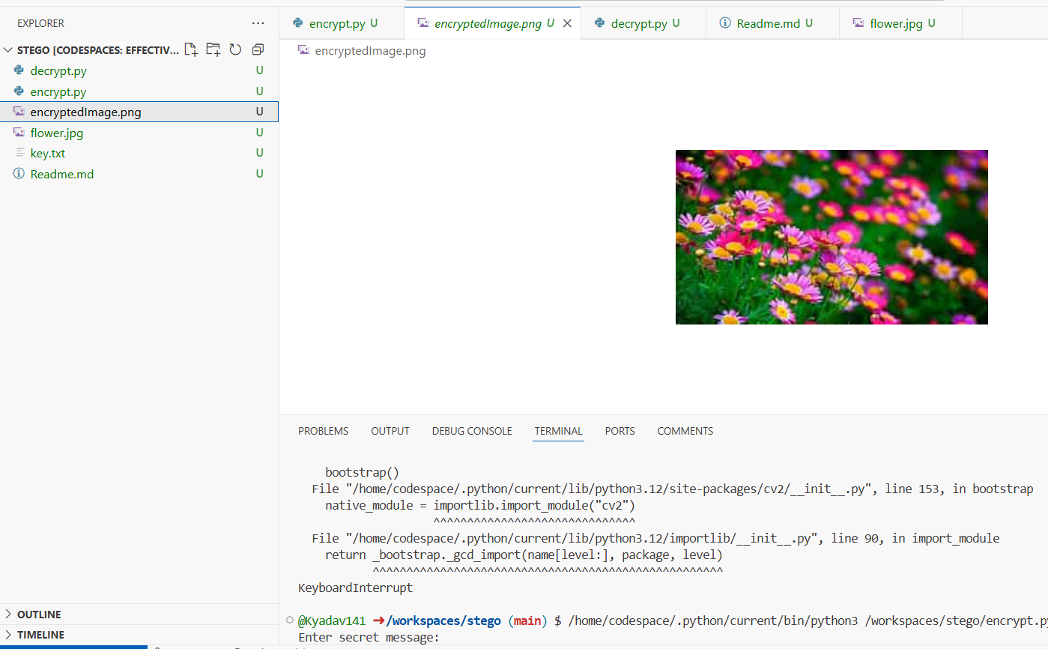
Results

Slide 8
Conclusion
Steganography provides a covert way of communicating sensitive information.
This project showcases a simple yet effective implementation of message hiding in images .
The GUI makes encryption and decryption accessible even to non-technical users.

Slide 9
GitHub Link
https://github.com/Kyadav141/stego.git

Slide 10
Future scope(optional)
Advanced Encryption Techniques
Support for Audio & Video Steganography
Mobile App & Web versions
Multilayer security

Slide 11
THANK YOU

